Slide 1

NLP Albumentation
ISM 6930 – DATA EXPLORATION, VISUALIZATION & ANALYSIS
By
Shailendra Singh & Enock Chemochek

Slide 2

Agenda
INTRODUCTION
ROADMAP
THE YELP DATASET
EXPLORATION
METHODS FOR AUGMENTATION
WHAT’S NEXT

Slide 3

INTRODUCTION
More YELP Reviews?
More quality data = better models
Boost model metrics for YELP reviews analysis
Hypothesis: By creating more observations we can create better clustering models that can distinguish between groups better.
What type of data to use?
Augmentation using a specific domain data might fail on data from different domain.
By obtaining data which comprises of diverse domains might help in solving data imbalance issue in classification related augmentation.

Slide 4

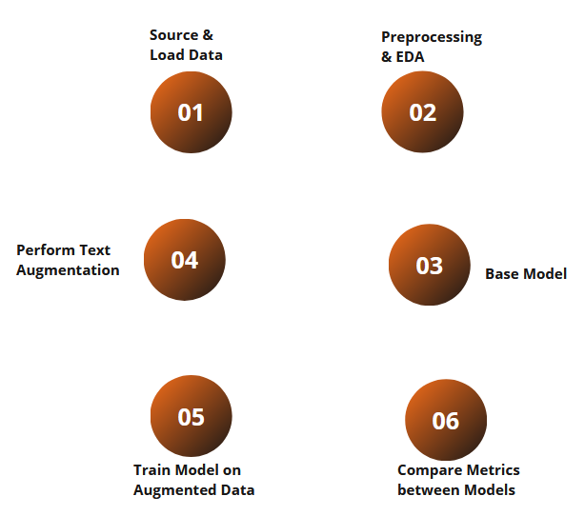
ROADMAP

Slide 5
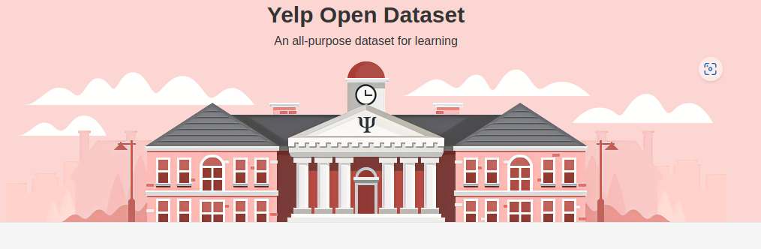
Yelp dataset contains user reviews on various businesses.
The reviews are long thus making augmentation more realistic.
The dataset is huge, hence test-train-validation split can be diversified easily.
Source: Yelp Dataset. (2019). Yelp.com. https://www.yelp.com/dataset

Slide 6

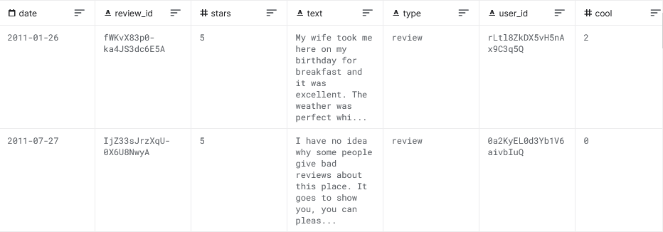
THE YELP Data
Useful Attributes: Text and Type
Use text to augment, use type for soft evaluation on target text.

Slide 7

Augmentation Techniques
Random Insertion, Deletion, and Swap [1].
Adding synthetic noise [2].
Keyword Replacement [3]
Synonyms
Hyponyms
Hypernyms
[1] (Wei and Zou, 2019) https://aclanthology.org/D19-1670/
[2] (Belinkov and Bisk, 2017) arXiv preprint arXiv:1711.02173
[3] (Toutanova et al., 2003)
https://dl.acm.org/doi/10.3115/1073445.1073478

Slide 8
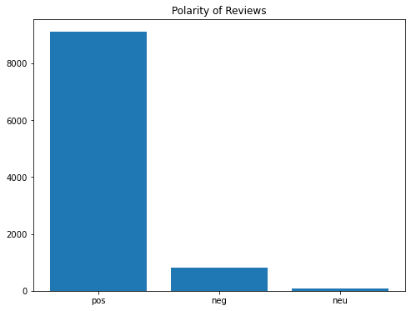
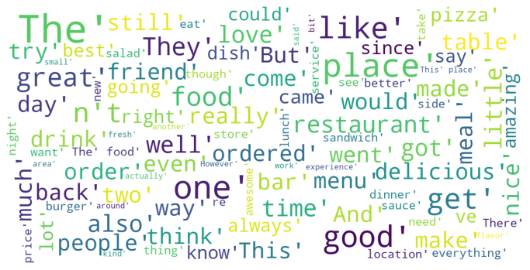
EXPLORATION
Overall sentiment
Word cloud (top 100 words)

Slide 9
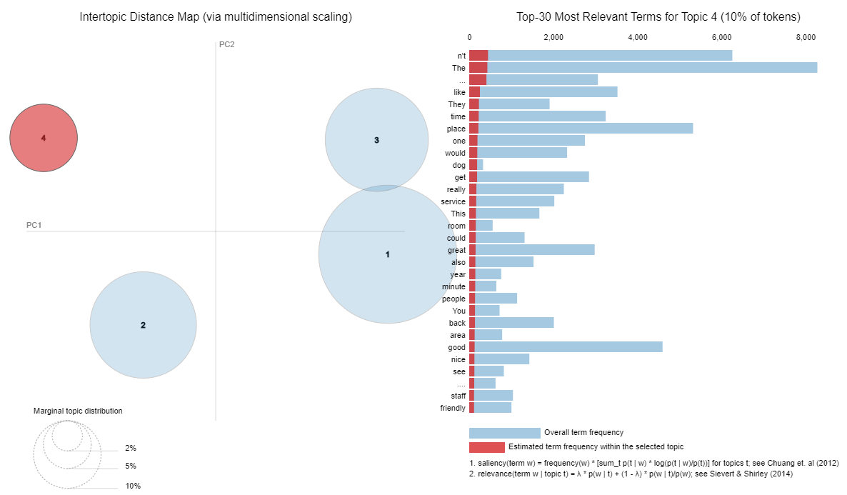
TOPICS

Slide 10
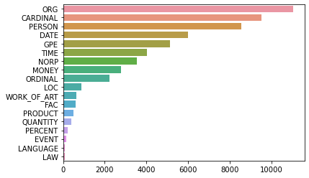
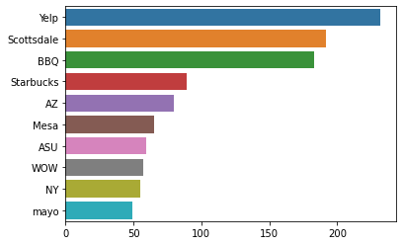
NER Distribution
Overall NER entities
Organizations

Slide 11
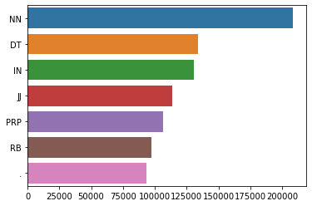
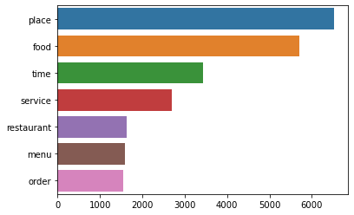
POS Distribution
POS tags overall
Nouns (NN)
NN: Noun, VB: Verb, JJ: Adjective, RB: Adverb, IN: Preposition, CC: Conjunction, PRP: Pronoun, INT: Interjection

Slide 12

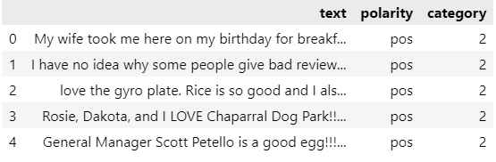
Data labeling
No labels? No problem!
Text > sentiment score > sentiment class

Slide 13
ROADMAP

Slide 14
Base model
XGBoost Classifier
gbtree booster
Gamma: 0
Learning rate: 0.3
100 estimators
Input: TFIDF (normalized, max_df =0.95, min_df = 0.05)
Metrics:
F1: 0.5318
Accuracy: 0.7540

Slide 15
AUGMENTATION
Type | Transformed
Original Sentence | The Dark Knight trilogy is the best collection of movies.
Entity Replacement (Noun) | The Dark Knight trilogy is the best collection of adaptation.
Synonym Replacement (Verbs, Adverbs, etc.) | The Dark Knight trilogy is the serious collection of adaptation.
Antonym Replacement (Verbs, Adverbs, etc. | The Dark Knight trilogy is the badly collection of adaptation.

Slide 16
AUGMENTATION
Type | Transformed
Original Sentence | Is Mini Cooper the fastest car in this price segment.
Entity Replacement (Noun) | Is portable the fastest smith in this price segment.
Synonym Replacement (Verbs, Adverbs, etc.) | Is portable the flying smith in this price segment.
Antonym Replacement (Verbs, Adverbs, etc. | Is portable the slow smith in this price segment.

Slide 17
AUGMENTATION
Type | Transformed
Original Sentence | I love this hotel. The beds are comfortable, and the service is great!
Entity Replacement (Noun) | I love this phone. The beds are comfortable and the luxury is great!
Synonym Replacement (Verbs, Adverbs, etc.) | I honey this phone. The beds are prosperous and the luxury is full!
Antonym Replacement (Verbs, Adverbs, etc. | I hate this phone. The beds are uncomfortable and the luxury is badness!

Slide 18
ROADMAP

Slide 19
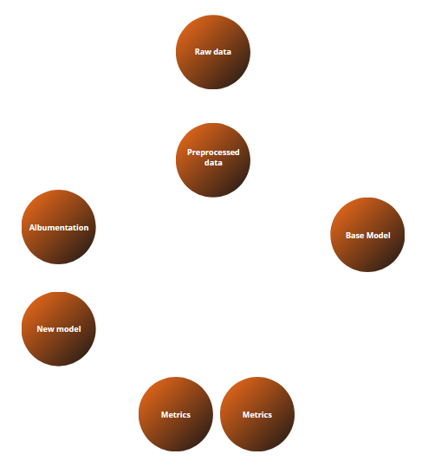

Slide 20
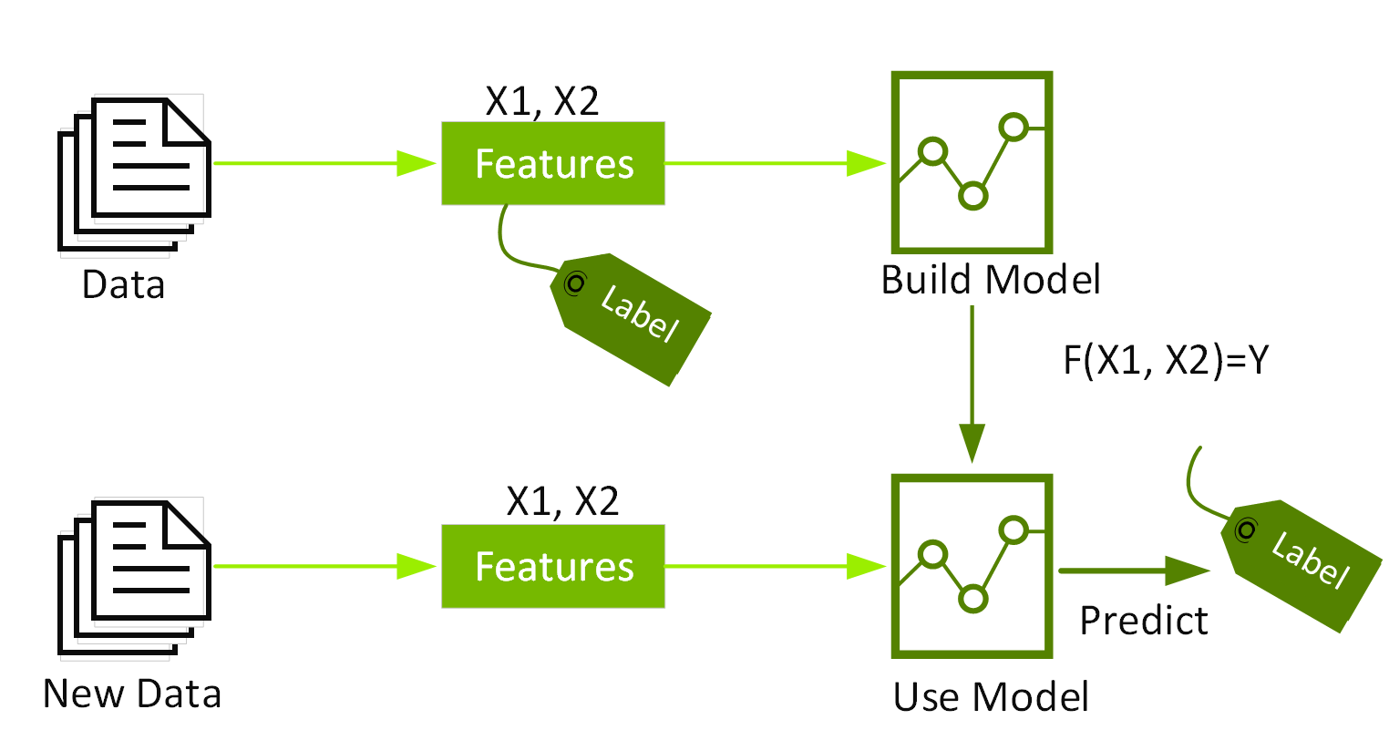

Slide 21
NEW Model
XGBoost Classifier
gbtree booster
Gamma: 0
Learning rate: 0.3
100 estimators
Input: TFIDF (normalized, max_df =0.95, min_df = 0.05)
Metrics:
F1: 0.8612
Accuracy: 0.9395

Slide 22
CONCLUSION
 | Original Data | Augmented Data
F1 Score | 0.5318 | 0.8612
Accuracy | 0.7540 | 0.9395
NLP albumentation promises better modeling process by availing more data

Slide 23
THANK YOU

